Slide 1
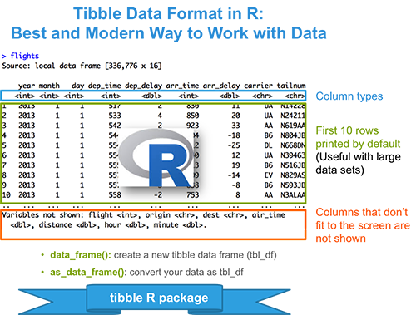
Lesson 18: Cleaning data
SE370 – Computer-Aided Systems Engineering
MAJ Jae Kim DSE- Instructor

Slide 2
Today
Lesson 18: Cleaning Data
  1. Clean, manipulate, and create data frames using tidyr
  2. Know the difference between a tibble and a data frame.
  3. Understand and apply gather(), spread(), separate(), and unite() to create the tidy format
2

Slide 3
Next Time
Lesson 19: dplyr
  1. Transform data using the dplyr package
  2. Understand and apply six basic dplyr functions to manipulate data (filter/arrange/select/mutate/summarize/grouping)
3

